Slide 1
R from the VeRy Beginning - Installation
Joe Cursio (jcursio@ben.edu and jcursio@stuart.iit.edu)
DuPage R Users Group
October 23, 2018 (Lisle, IL)
Notes:
Sorry about the capital R in the word very.
This has become an inside joke among the organizers of the Chicago R Users Group,
And I could not resist.
I didn’t spell it that way on the meetup website – because I didn’t want people to know how nerdy I am.
But I’m pretty sure you all realize by now, there’s no point in me attempting to hide it.

Slide 2

A Word from Our Sponsors
from Travis Linderman "Please mention that on November 16th (3PM) that Innovation DuPage will be sponsoring a Tech Founders Panel at Benedictine featuring four venture-backed female founders and that will lead into the Analytics Hackathon. You can also mention that the Innovation DuPage Headquarters (IDHQ) will be opening to tech startups, developers and entrepreneurs in April of 2019 and they can reach me directly to learn more or to meet in person at ID@cod.edu."

Slide 3
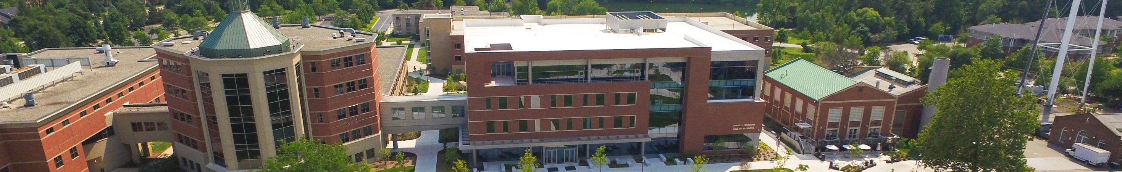
A Word from Our Sponsors
Benedictine University offers classes.
Talk to me
See www.ben.edu for more information

Slide 4
At Any Time, Feel Free To ___
Interrupt me and ask questions
Have me repeat something and/or slow down
Have someone see what’s on your laptop
Talk with other people
…

Slide 5
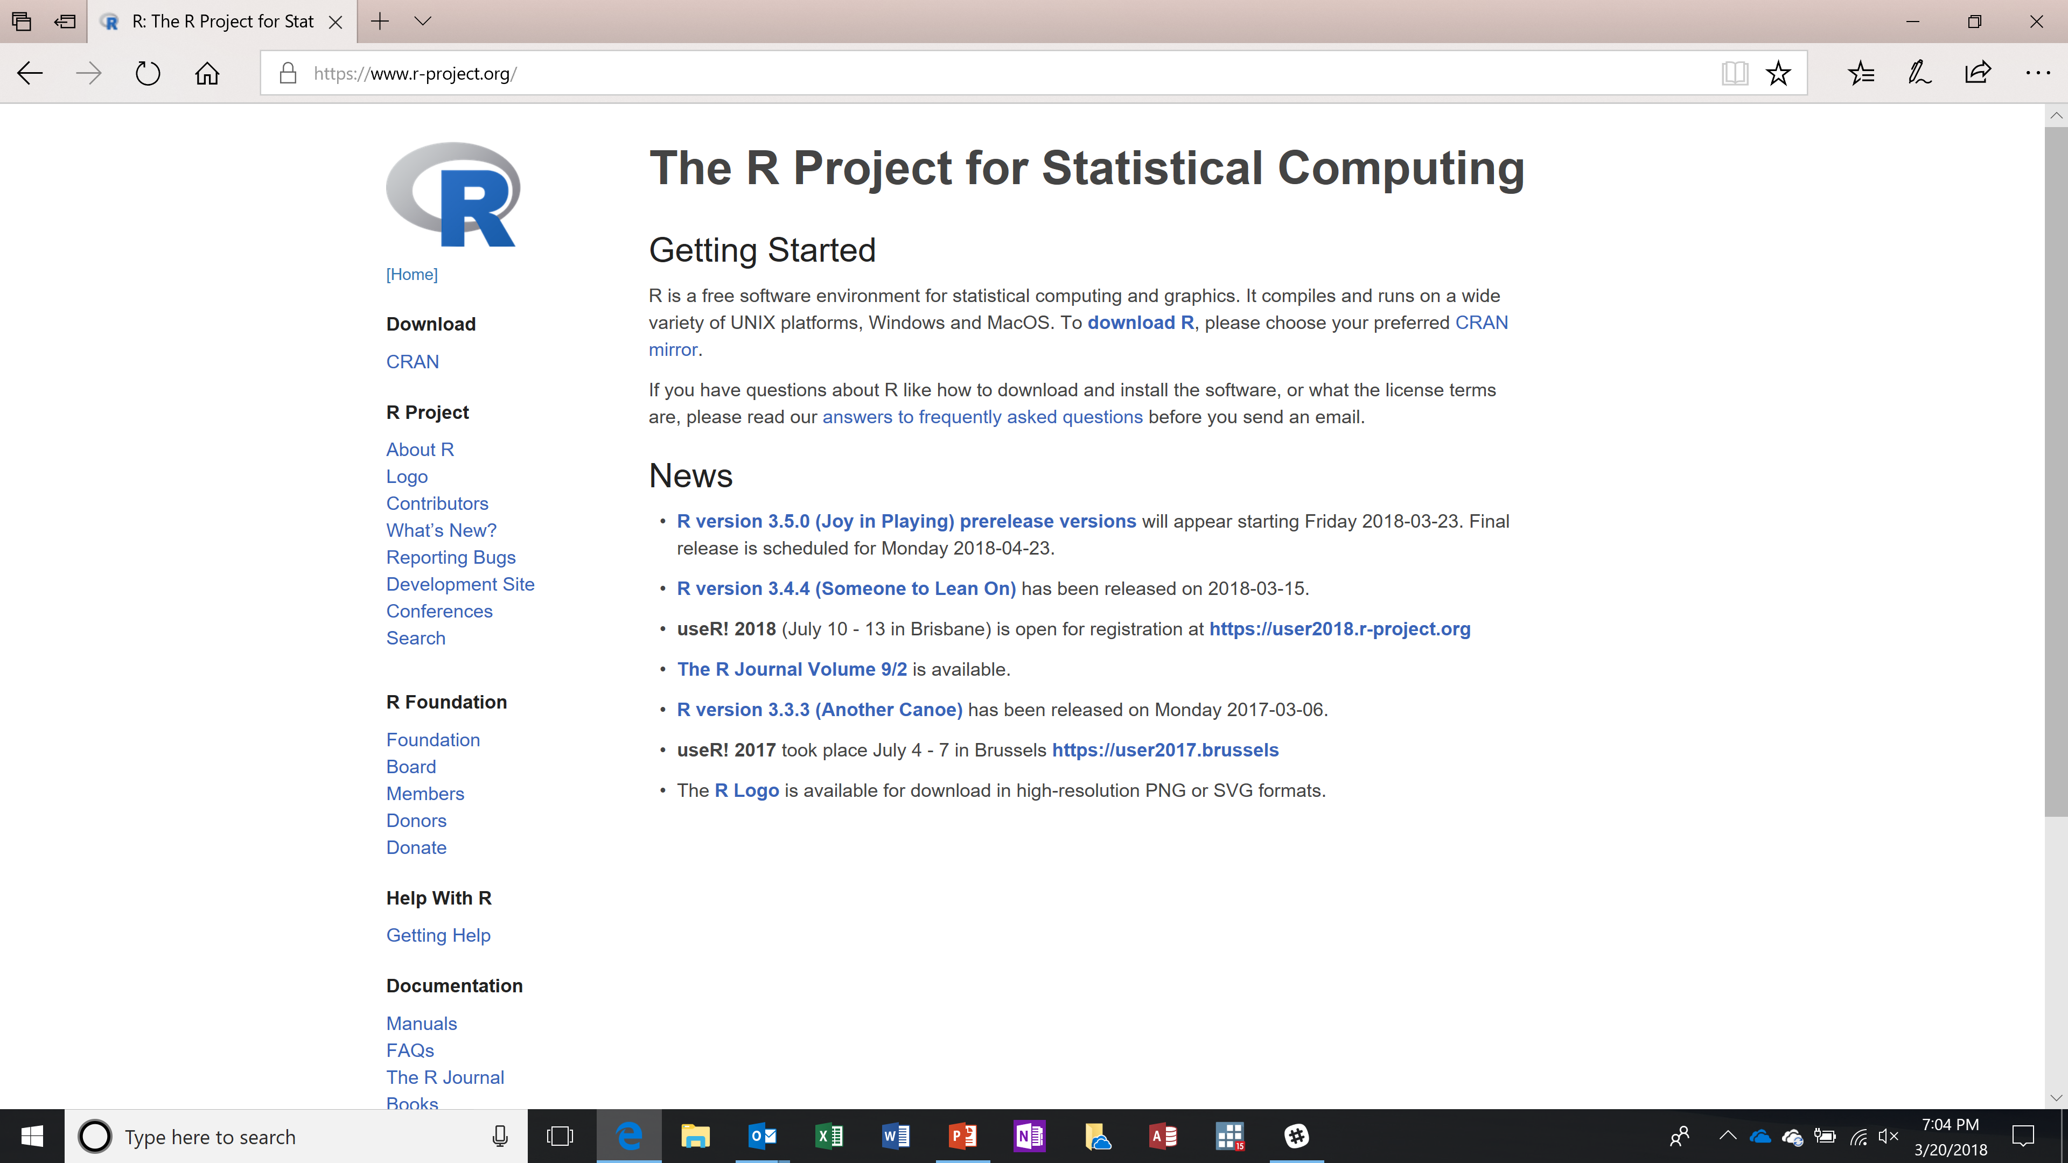
Where to Find the Software
I googled “R project” to find www.r-project.org
The home page looks a little something like this.
I then went to download and installed on windows.
I hope Apple and Linux are just as easy to install
Notes:
If you look to the left, you’ll see a DOWNLOAD CRAN section.
Select that
Find a download site close to here
Select the operating system you use (for me its Windows)
Select the default options such as “base”
CRAN is an acronym that stands for (I don’t really care)
And I’m not sure of the proper way to pronounce it as a word. I say “cran” as in “cranberry.”

Slide 6
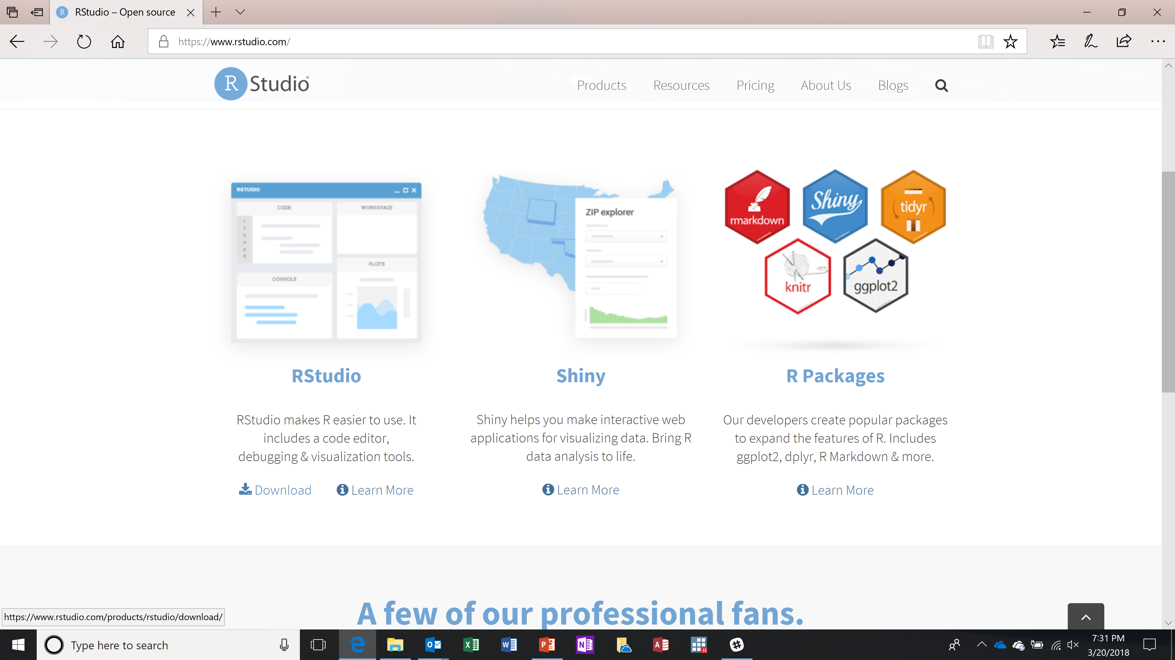
Where to Find the Software
I googled “R studio” to find https://www.rstudio.com/
Among other things, the company Rstudio has a free product called “rstudio.”
So I downloaded that as well. (I chose the free open source desktop version)
I also created a shortcut on my desktop.
Notes:
This is where we find the better user interface. It’s called “R Studio”
The company called R Studio has other products that are really nice, but for now we want the better user interface

Slide 7
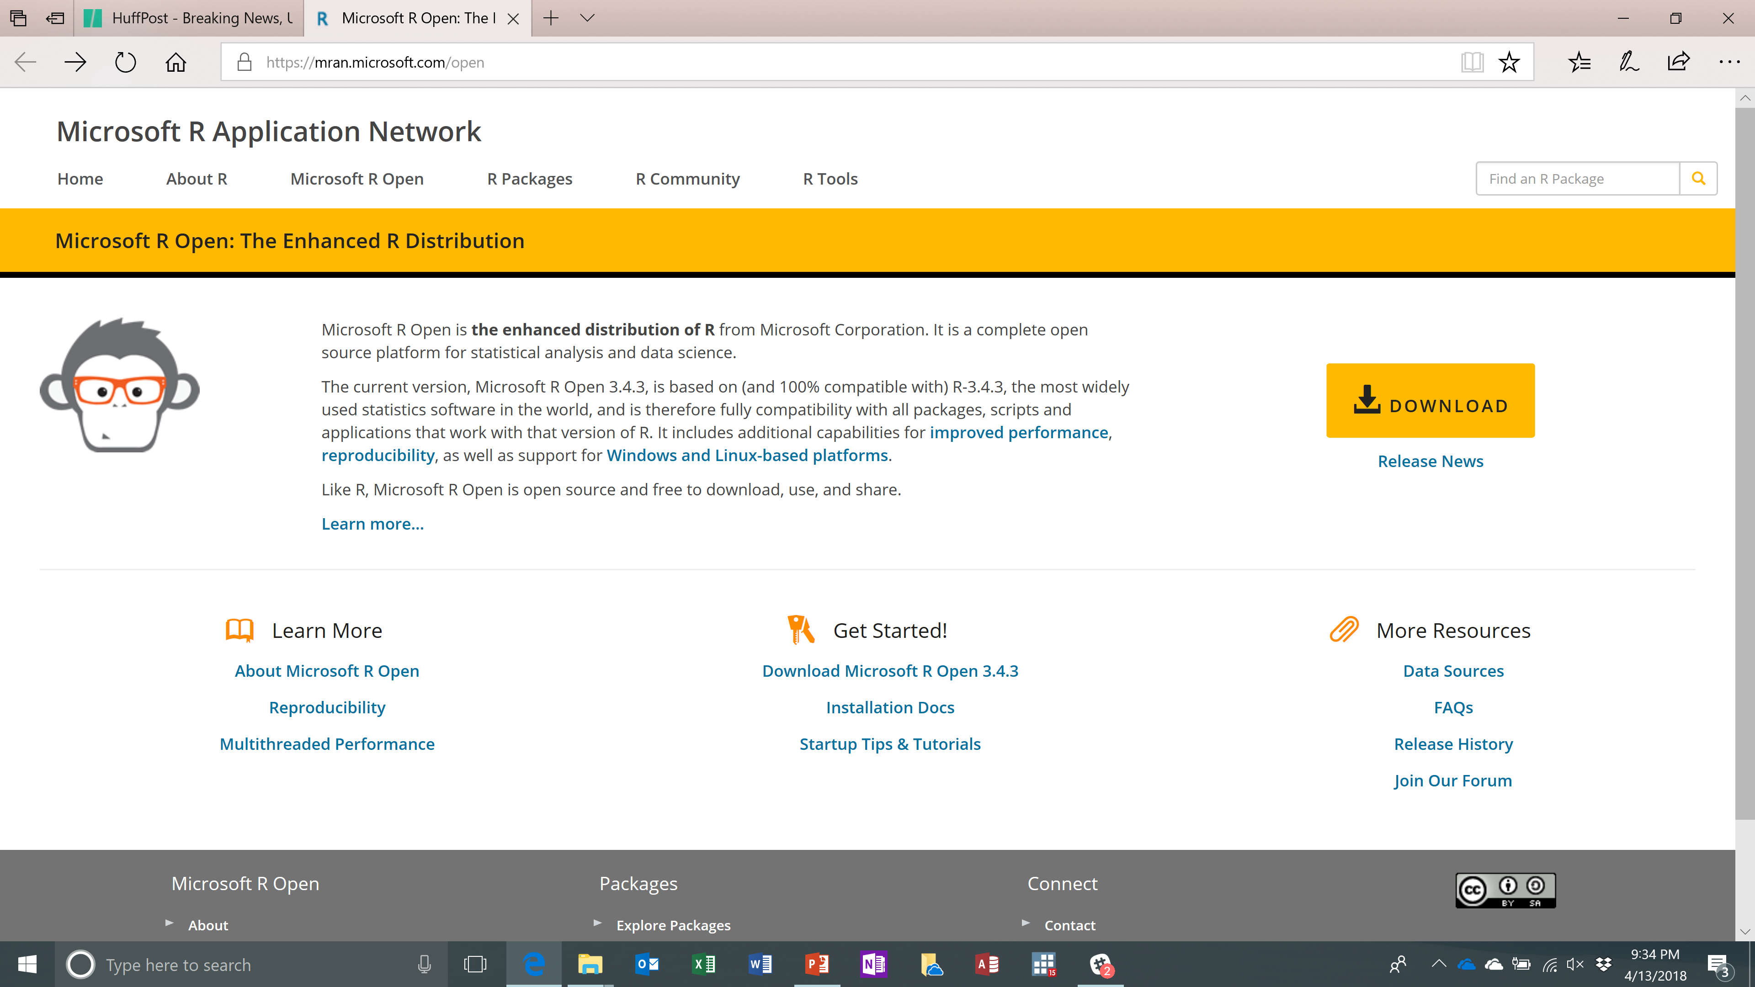
Where to Find the Software
I googled “Microsoft R” to find their open-source implementation of R.
I then went to the download site and installed it.
Among other things, it has multi-threaded math libraries.
Notes:
This is optional, and I’m not going to discuss this today. But this is worthy of consideration.

Slide 8
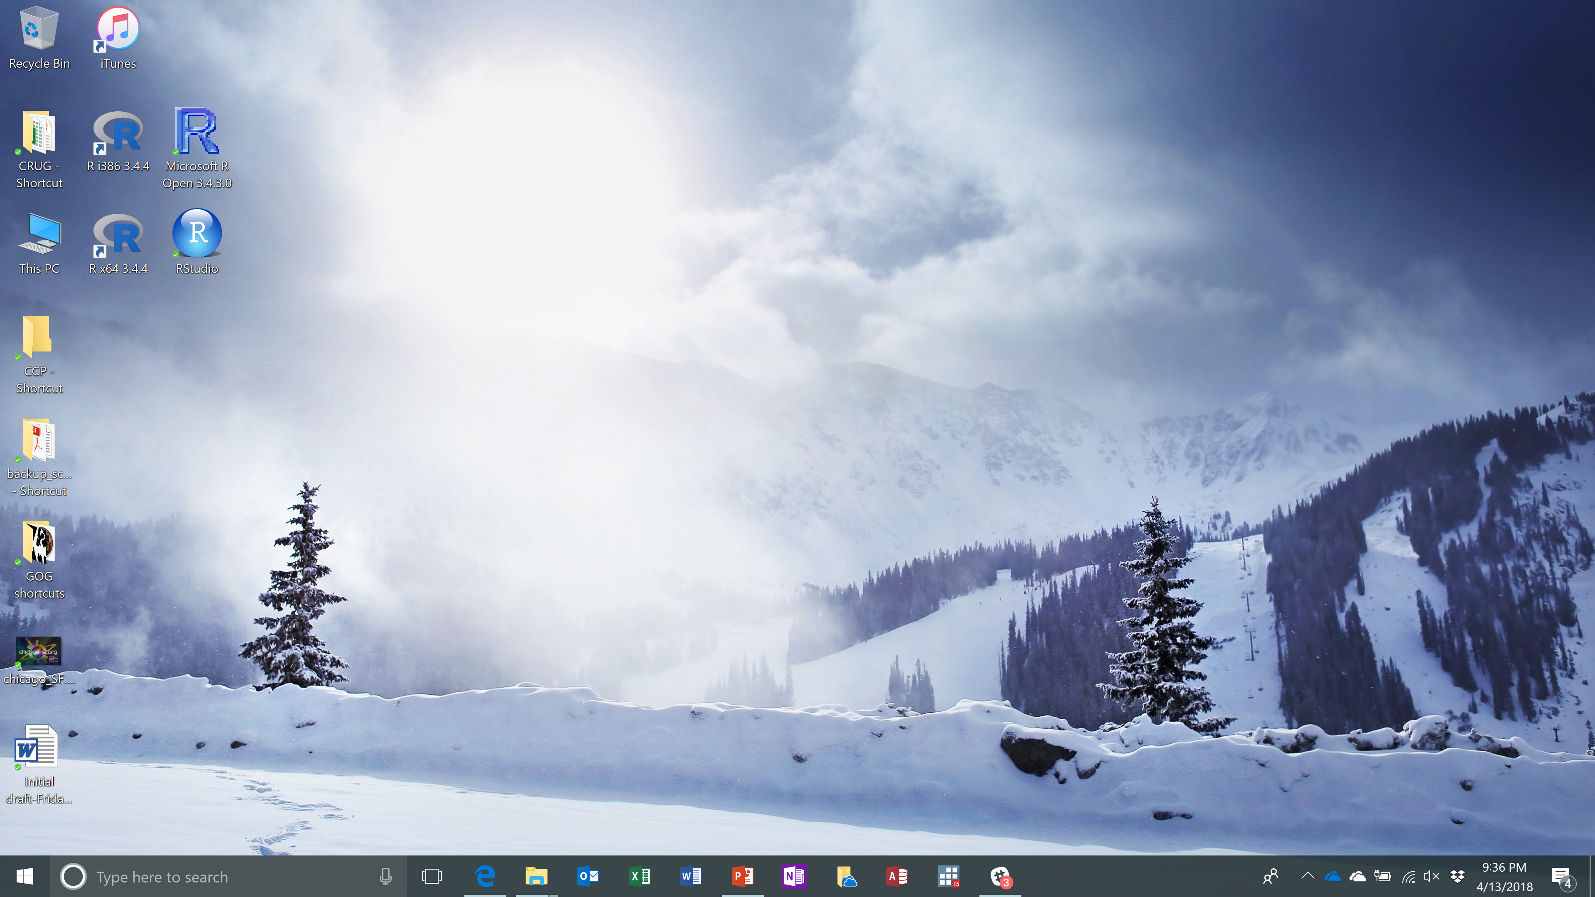
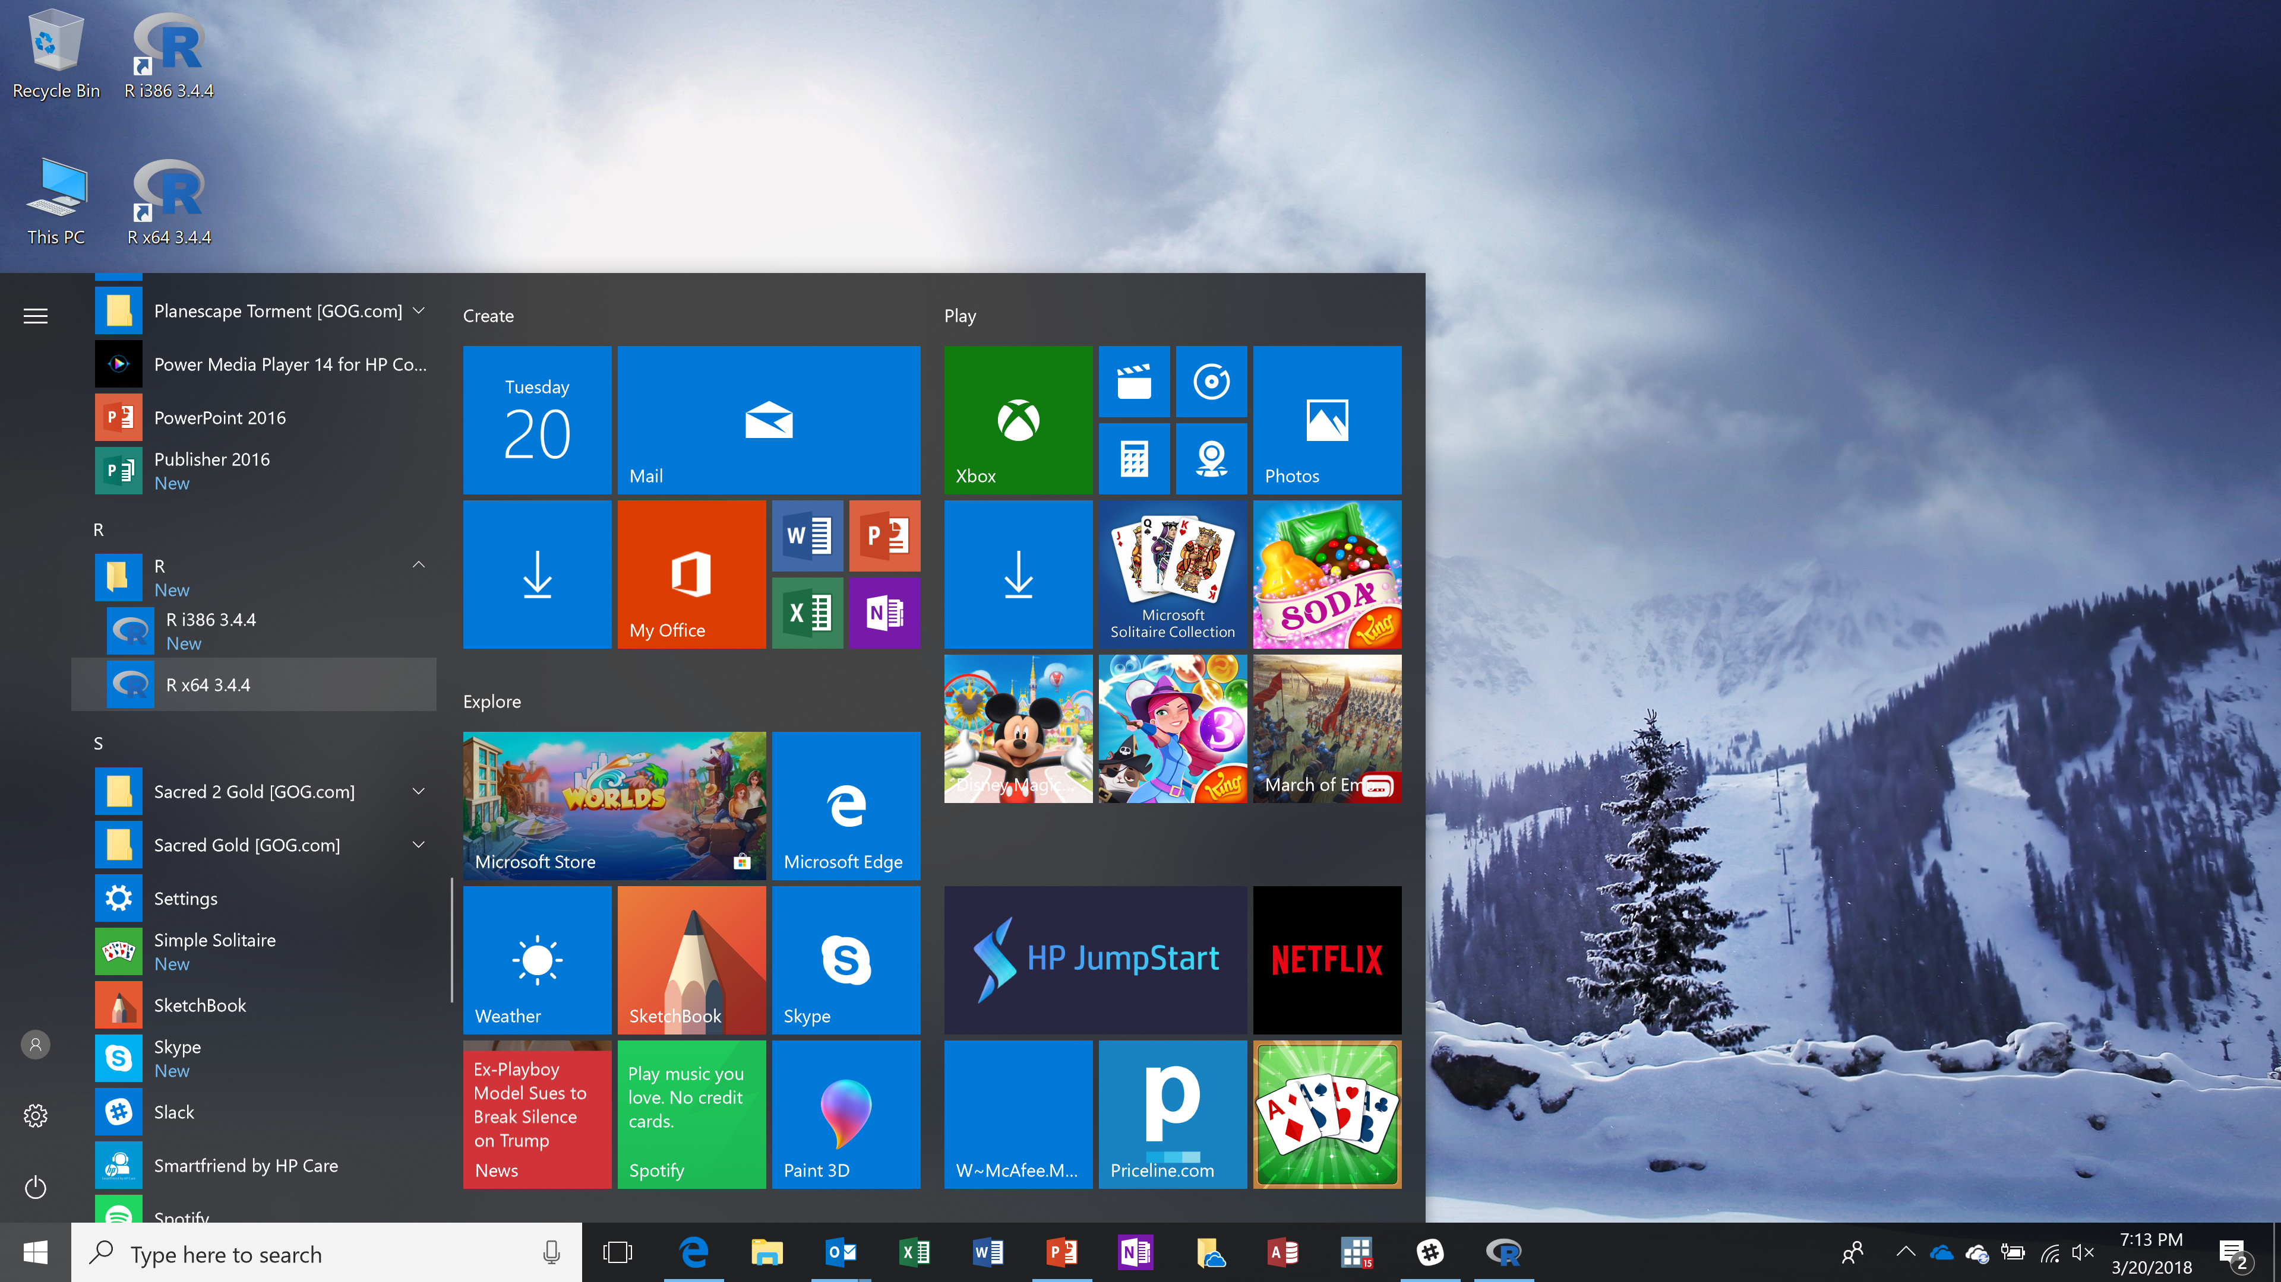
Starting R in Windows
Windows set up both shortcuts on the desktop and on the start bar for me.
It also installed both 32-bit and 64-bit versions of R.
I also created shortcuts for both RStudio and Microsoft’s R
Sorry, I don’t know how this works in Apple and Linux. Hopefully, it works very much the same way
Notes:
For me, after the installation process was finished, I can start R in two ways:
I have some shortcuts on my desktop
It is also in the Windows start menu
I also installed both the i386 version which is 32-bit, and the x64 version which is <pause>
“Beuller-Beuller?”
<pause>
bit.
If you’re using Apple or Unix, starting the program will be a bit different for you. Sorry I cannot help you much.
I only use Windows.

